Slide 1
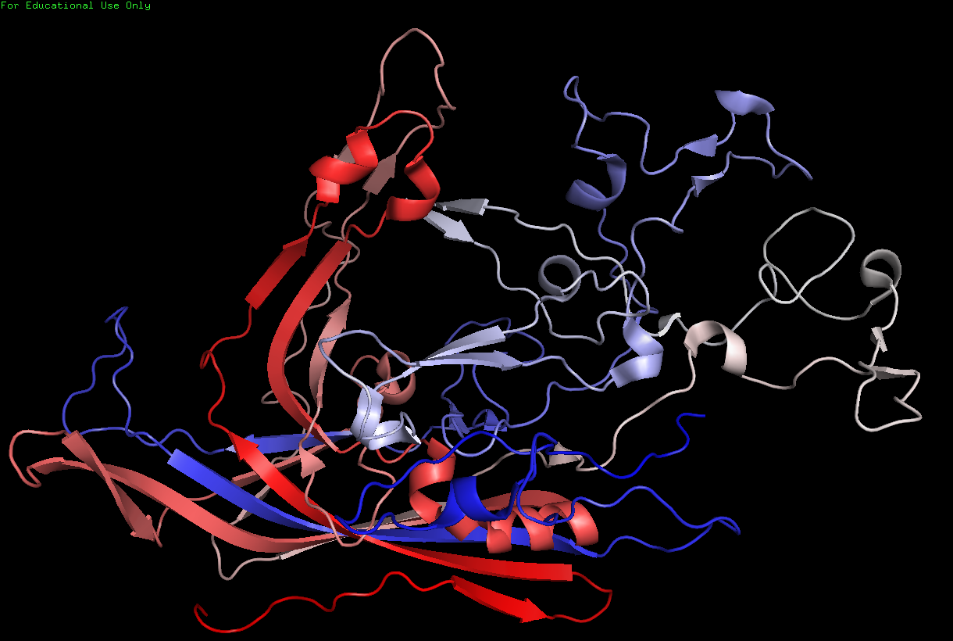
Loop 1
Loop 4
EXTERIOR
Loop 2
HI Loop
Loop 3
βC
(587) - COOH
βH
βE
DE Loop
βI
βF
αA
βD
βG
βB
2
5
INTERIOR
H₂N - (39)
βA
3

Slide 2
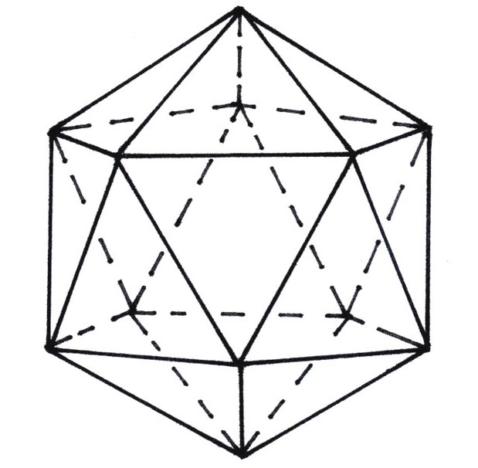

Slide 3
